Slide 1
GMAL Training

Slide 2
GMA Lite Overview

Slide 3
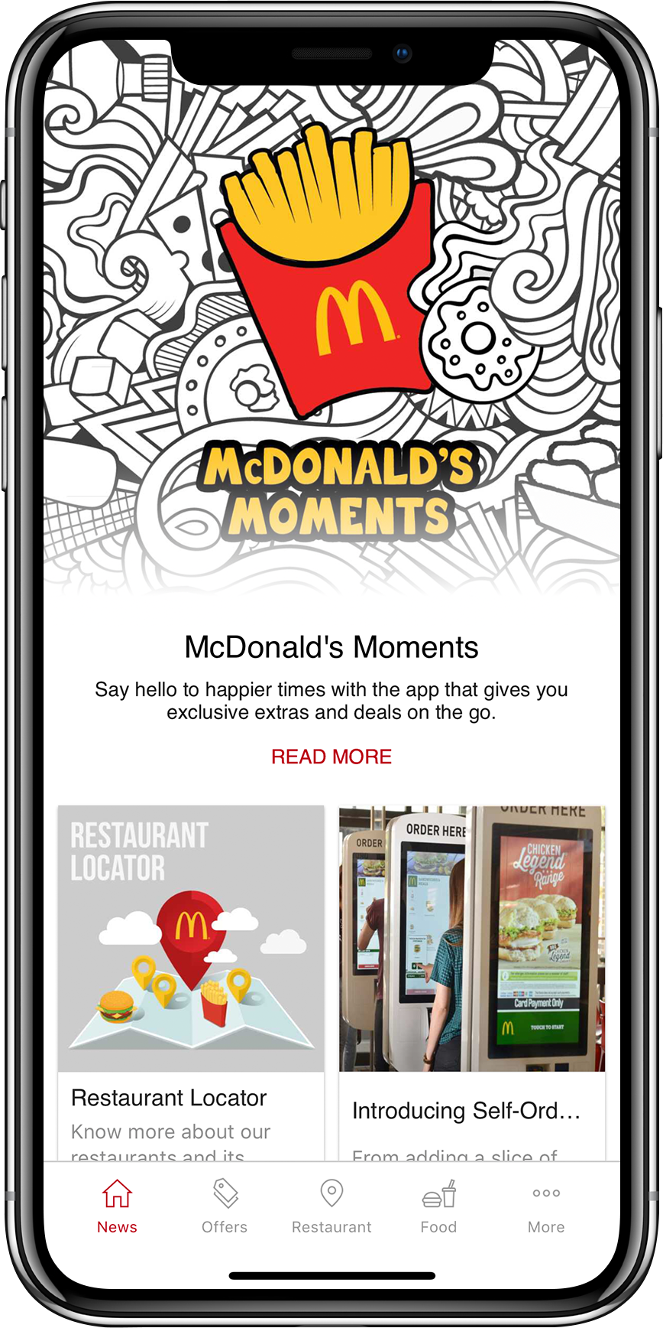
What is GMA Lite ?
    An app that provides targeted offers and engagement opportunities with our customers to drive GCs in our restaurants.

Slide 4
Single App, Single Publisher Model
GMA Lite is a single global app for all market published by McDonald’s Global Markets.
Benefits:
  Every market gets access to upgraded with new functionality at the same time.
  We can rapidly release updates on a more frequent schedule.
  Development time is focused on app improvements rather than individual market localization.
  Registered user don’t need to re-register to access another market’s GMA Lite app
Single instance of Plexure and the App Engine
  Fast - to deploy to markets as the backend is already setup
  Simple - to manage and support in the future
  Cheap - to run with no new setup fees or extra hosting fees for each new market

Slide 5
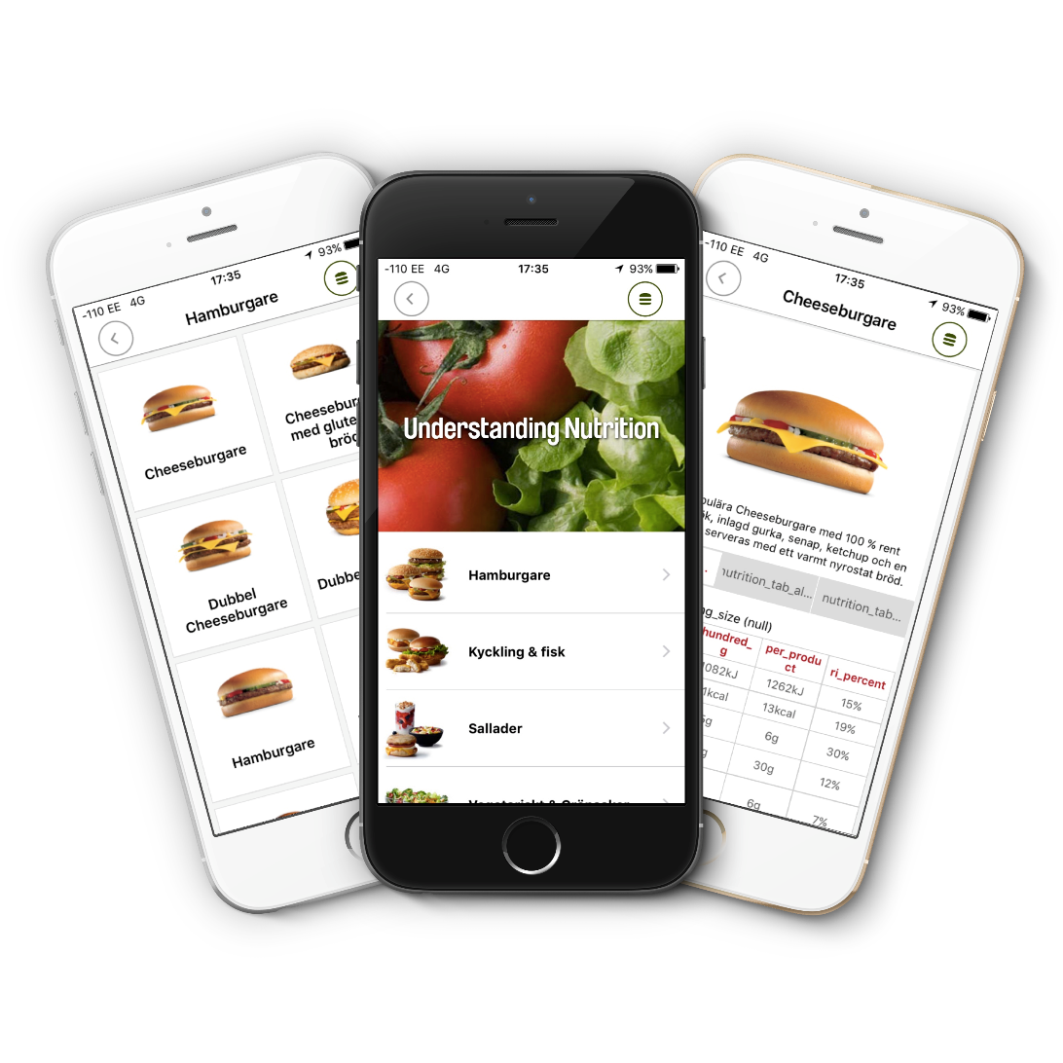
Demo

Slide 6
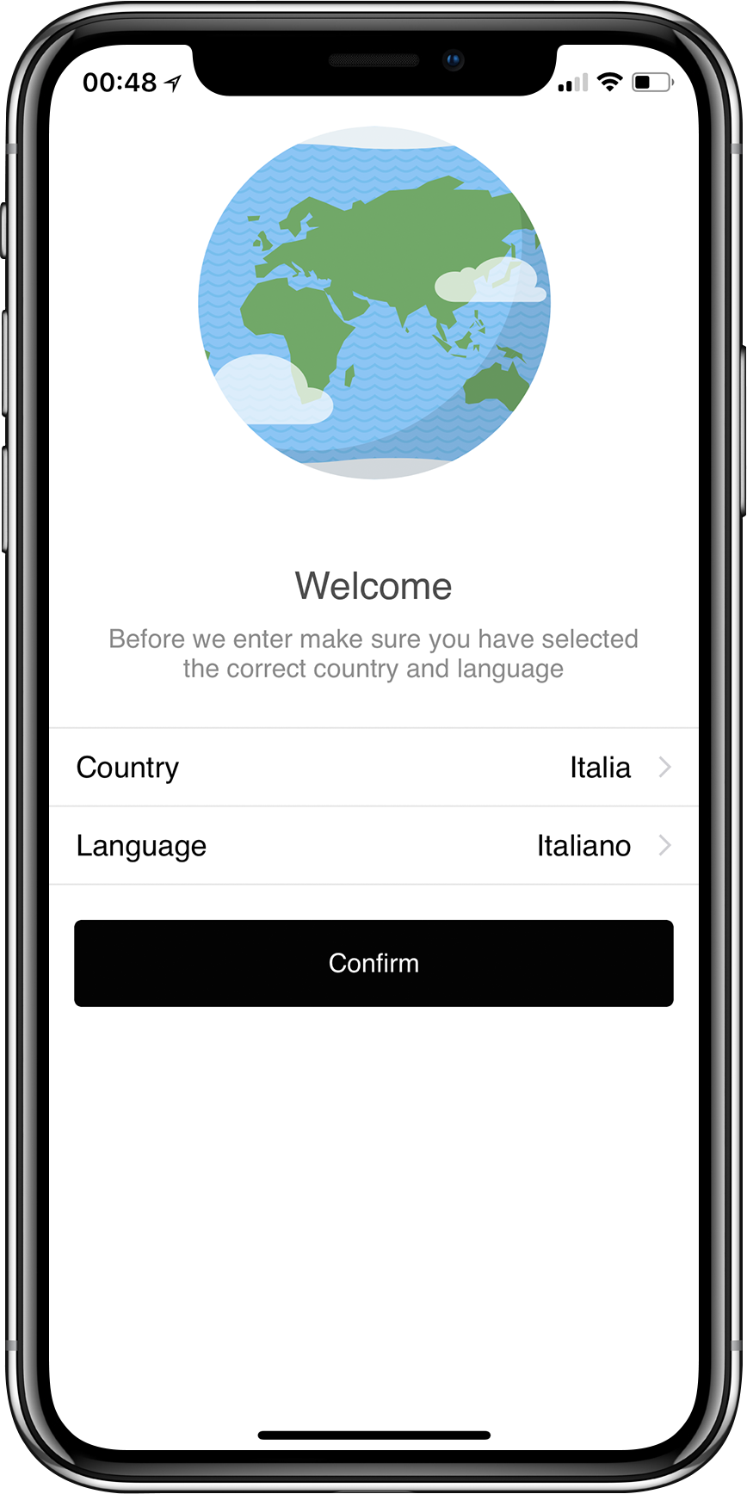
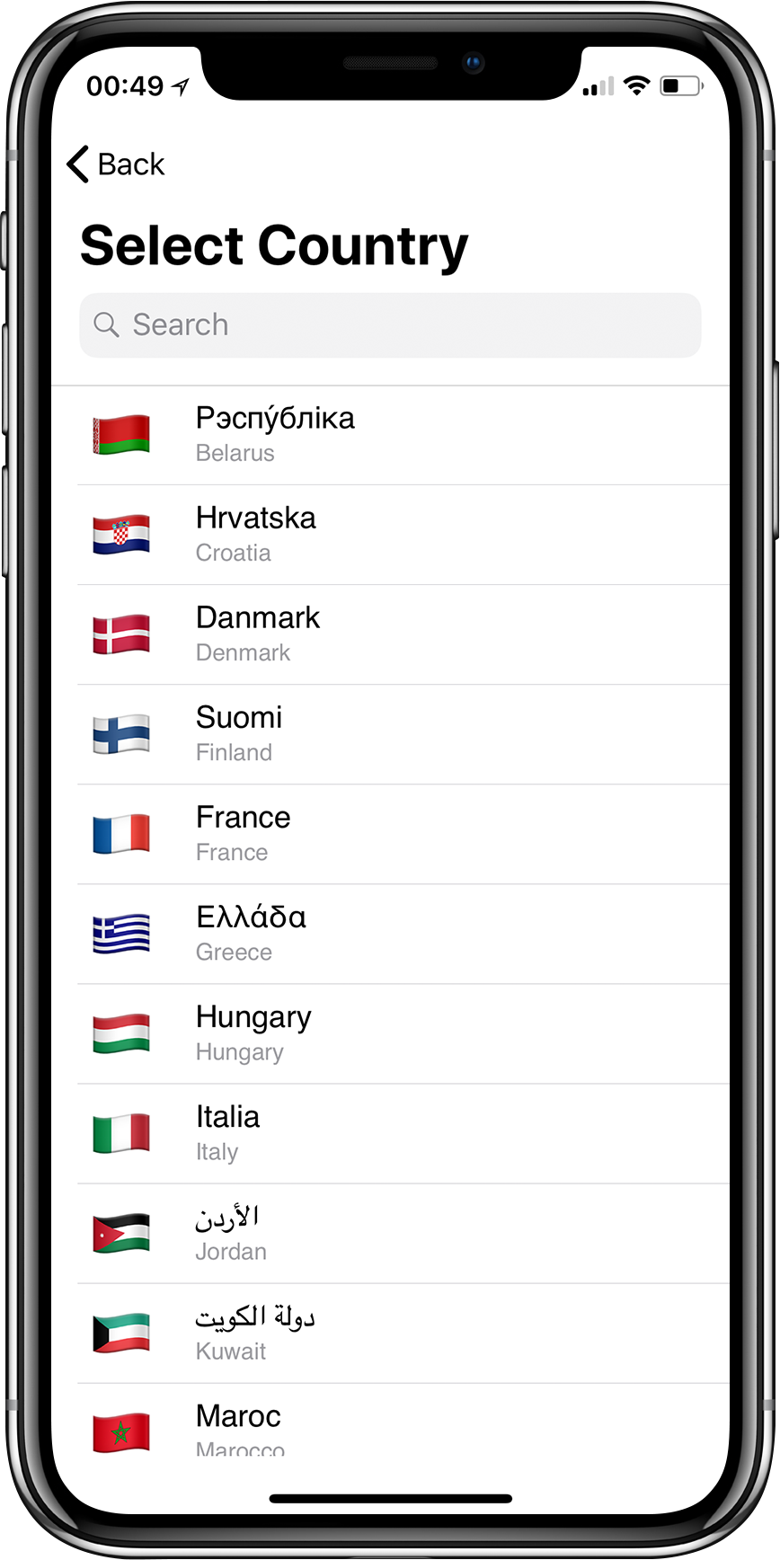
Market Picker
Customer chooses the country/region that they want to use the app in, first time they download the app
Market picker can also be selected from the side menu which allows customers to switch to an entirely different country without downloading a new app.

Slide 7
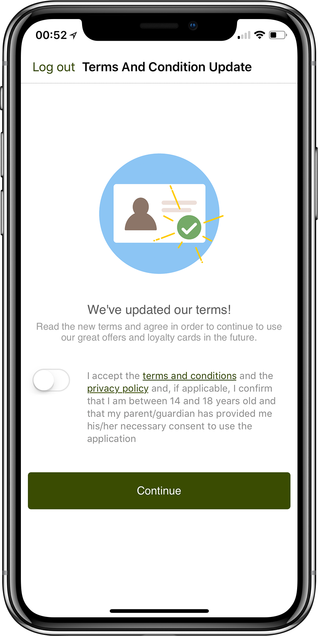
Switching to Different Market
When switching from sidebar -
  Customer account remains the same and they remain logged-in but they must accept the new market's Terms and Conditions, Privacy Policy and Age Restrictions before they can continue

Slide 8
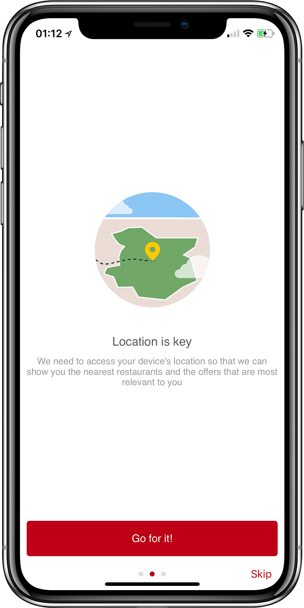
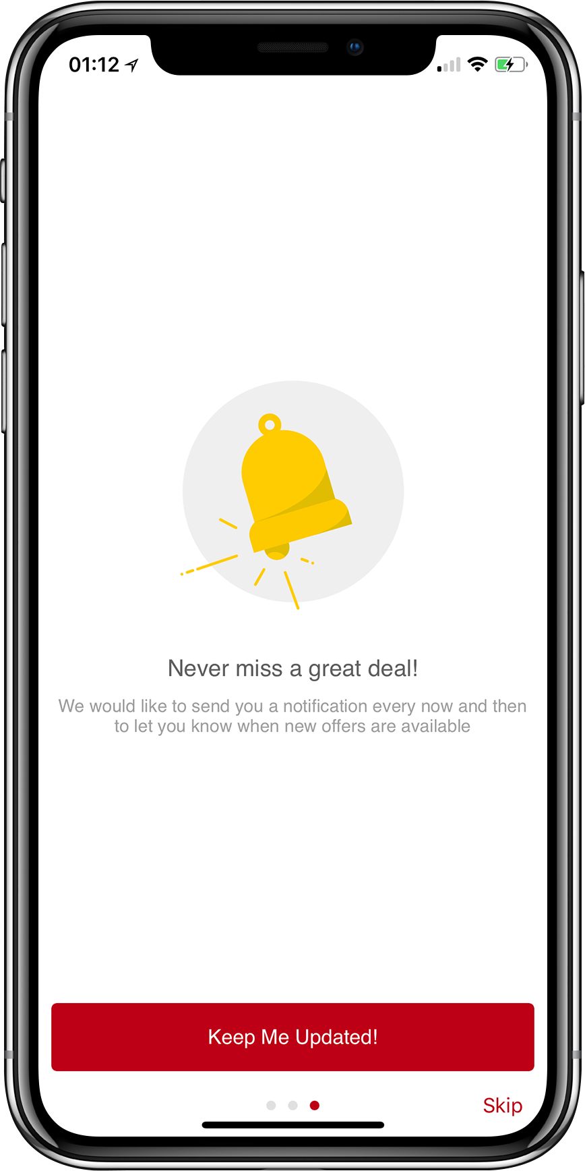
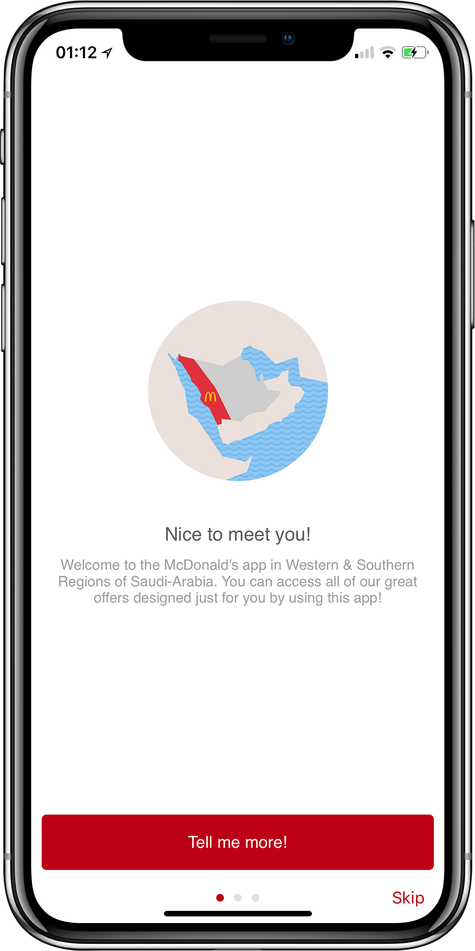
Onboarding Carousel
A collection of views with an image, a title, some summary text and a button
Great place to ask customers if they want to permit the McDonald's app to access the device's location and send the customer push notifications
Location Request
Notification Request
Custom View

Slide 9
Registration 'Thanks'
We can now configure that once the user signs up we can show a thank you for signing up
This helps to set the personalized tone with the consumer and build a connect

Slide 10
Designed for you – fast, flexible and relevant
    The homepage is the Centre of your online brand, a place for:
                Brand Engagement with refreshable and beautiful images and content
                Driving GCs and ACs
The front page tiles can be used to point users to specific offers, to the registration page or to a websites/microsites
Configure it to target the right message to the right customers
  Content can be both personalised and contextualized based on the user’s profile or a number of other conditions such as their current location or the weather.
Allows you to communicate to your customers with brand messaging, fully synchronized with your marketing calendar
Hero Banner decide the color of the background for the rest of the ‘Home’ view (bottom few rows of pixels of the image )

Slide 11
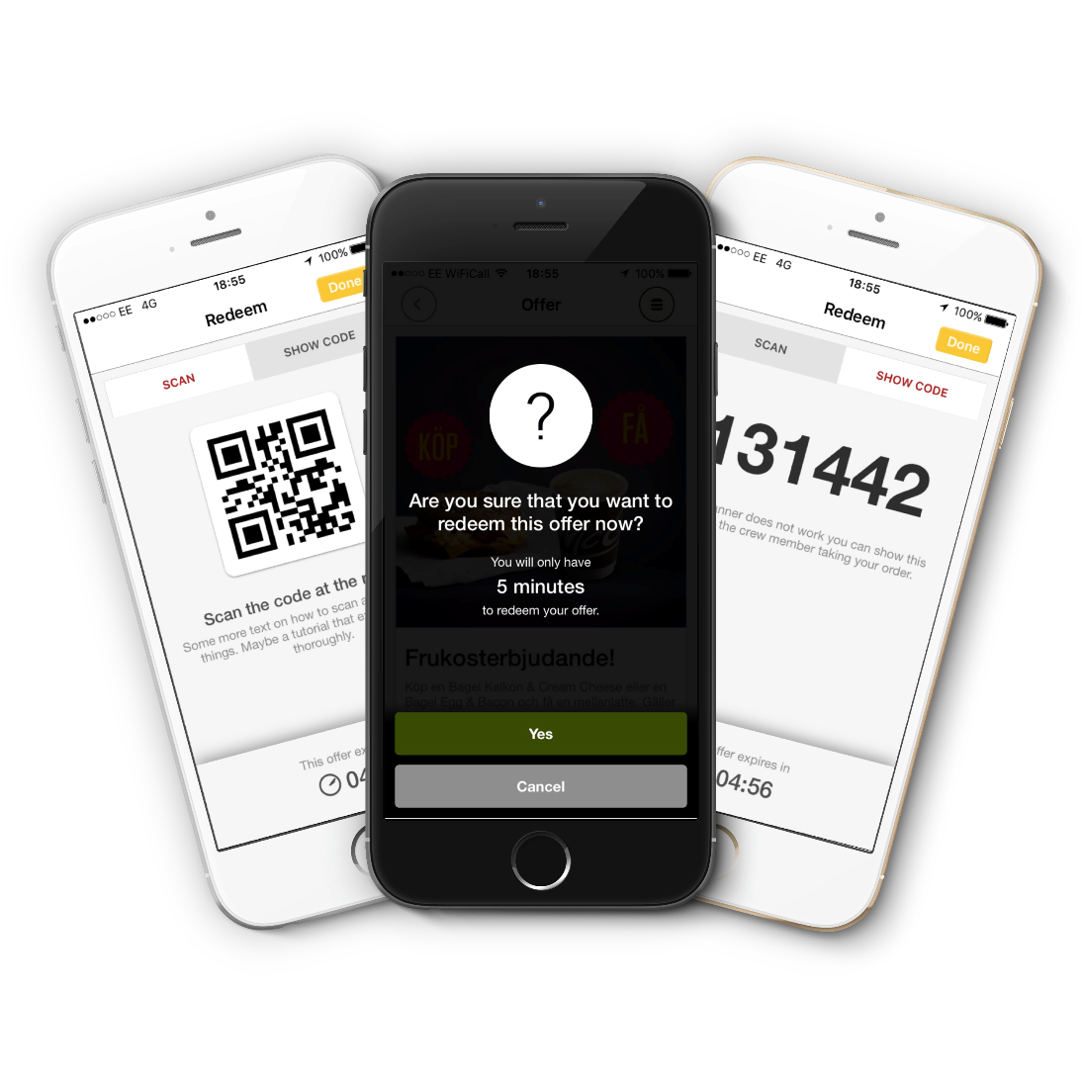
Targeting the right offers for the right customers
    Use performance data to build relevant and differentiated offers for different customers
    Fraud prevention capabilities
    Customer tutorials
    Customizable Terms and Conditions for each offer redemption

Slide 12
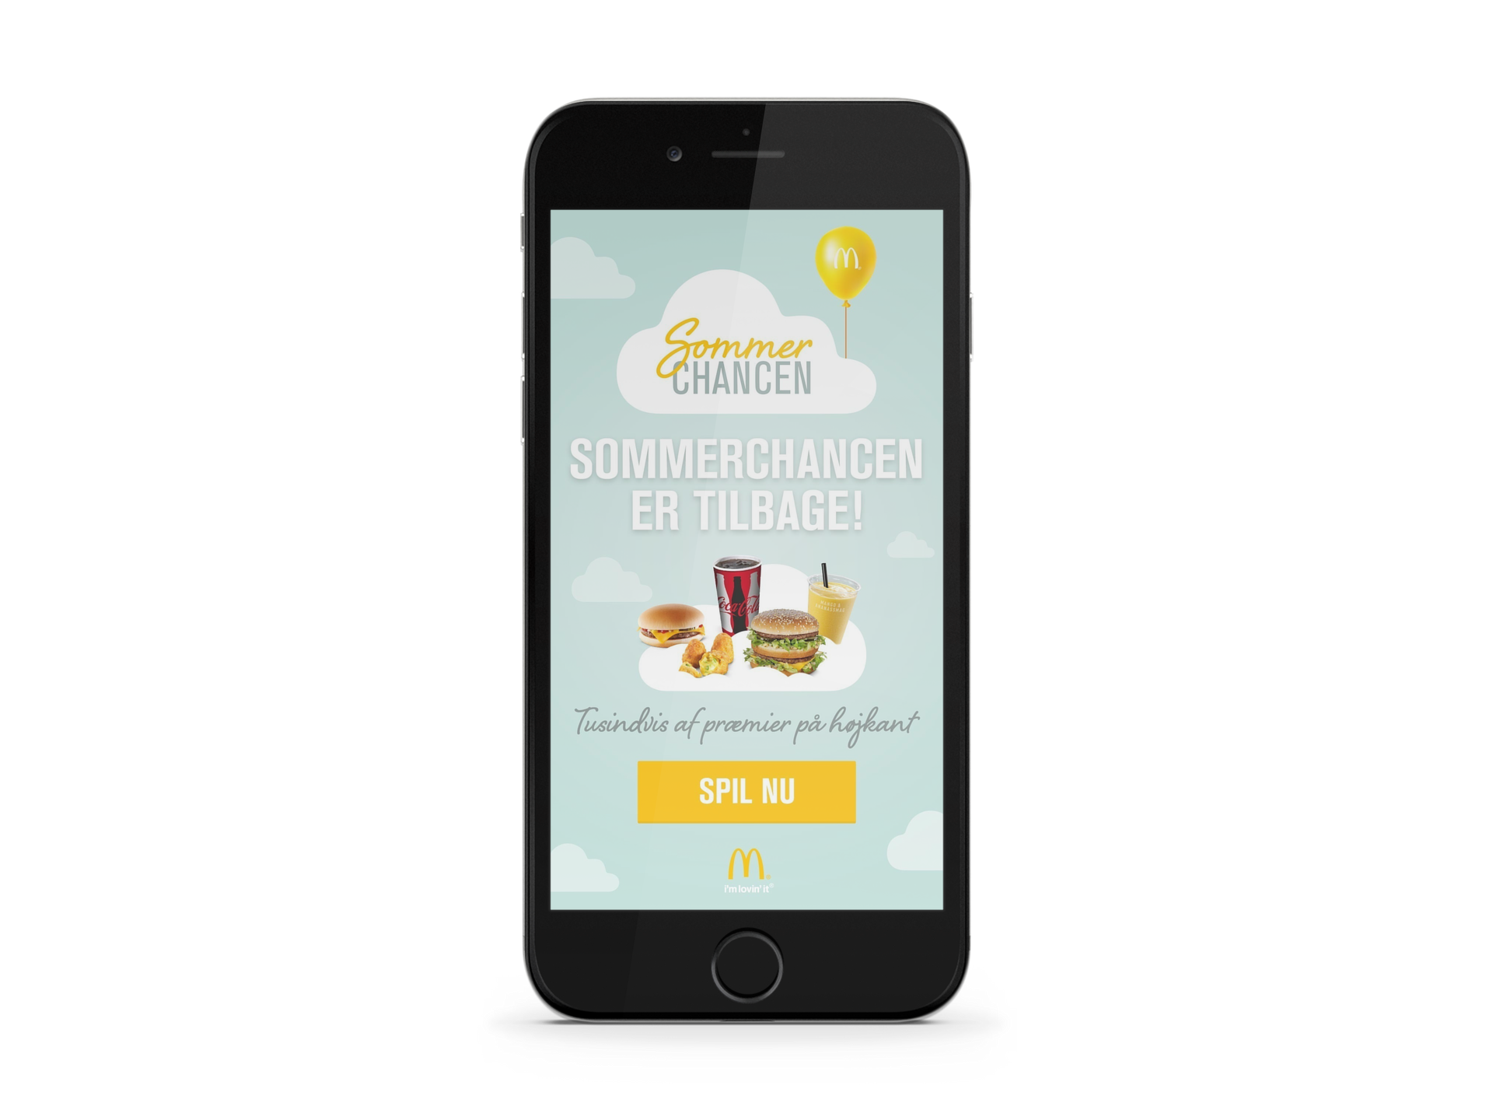
“App within app” capability
Use Smart Web Views to enhance the experience with your local apps.
No need to update GMA Lite. Build local apps that could include Advent Calendars, Lunar New Year games, GC driver games or Monopoly.
Your agencies can incorporate exciting promotional functions using:
    Access to Customer Data
    Device Location Data

Slide 13
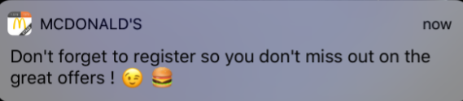

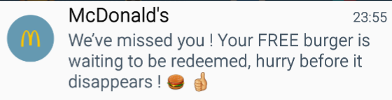

Push Notification Capability
    Targeted Push Notification for selected customer segments
    Supports both English and a local market language

Slide 14
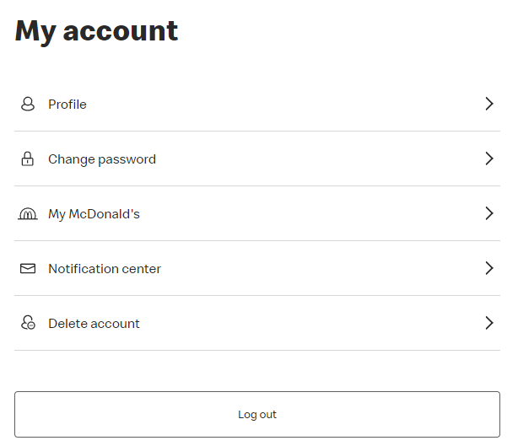
Profile Manager
    Web version of My Account page
    Update Profile
    Reset Password
    Loyalty Consent
    Marketing communications consent switches
    Account Deletion
    It can be accessed at https://mcdonaldsapps.com/en-GB/account

Slide 15
Feedback, questions?

